Slide 1
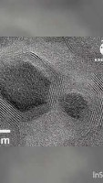
MM 203 Presentation
NANO PARTICLES!!!!

Slide 2
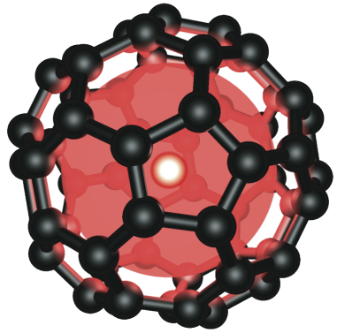
What is a Nano particle?
A nanoparticle or ultrafine particle is usually defined as a particle of matter that is between 1 and 100 nanometres (nm) in diameter. The term is sometimes used for larger particles, up to 500 nm, or fibers and tubes that are less than 100 nm in only two directions. Nanoparticles are usually distinguished from microparticles (1-1000 µm), "fine particles" (sized between 100 and 2500 nm), and "coarse particles" (ranging from 2500 to 10,000 nm), because their smaller size drives very different physical or chemical properties, like colloidal properties and ultrafast optical effects or electric properties. The properties of nanoparticles often differ markedly from those of larger particles of the same substance. Since the typical diameter of an atom is between 0.15 and 0.6 nm, a large fraction of the nanoparticle's material lies within a few atomic diameters of its surface. Therefore, the properties of that surface layer may dominate over those of the bulk material. This effect is particularly strong for nanoparticles dispersed in a medium of different composition since the interactions between the two materials at their interface also becomes significant.

Slide 3
Characterization
There are several overall categories of methods used to characterize nanoparticles. Microscopy methods generate images of individual nanoparticles to characterize their shape, size, and location. Electron microscopy and scanning probe microscopy are the dominant methods. Because nanoparticles have a size below the diffraction limit of visible light, conventional optical microscopy is not useful. Microscopy methods are destructive and can be prone to undesirable artifacts from sample preparation, or from probe tip geometry in the case of scanning probe microscopy. Additionally, microscopy is based on single-particle measurements, meaning that large numbers of individual particles must be characterized to estimate their bulk properties.
Spectroscopy, which measures the particles' interaction with electromagnetic radiation as a function of wavelength, is useful for some classes of nanoparticles to characterize concentration, size, and shape. X-ray, ultraviolet–visible, infrared, and nuclear magnetic resonance spectroscopy can be used with nanoparticles. Light-scattering methods using laser light, X-rays, or neutron scattering are used to determine particle size, with each method suitable for different size ranges and particle compositions. Some miscellaneous methods are electrophoresis for surface charge, the Brunauer–Emmett–Teller method for surface area, and X-ray diffraction for crystal structure, as well as mass spectrometry for particle mass, and particle counters for particle number. Chromatography, centrifugation, and filtration techniques can be used to separate nanoparticles by size or other physical properties before or during characterization.

Slide 4
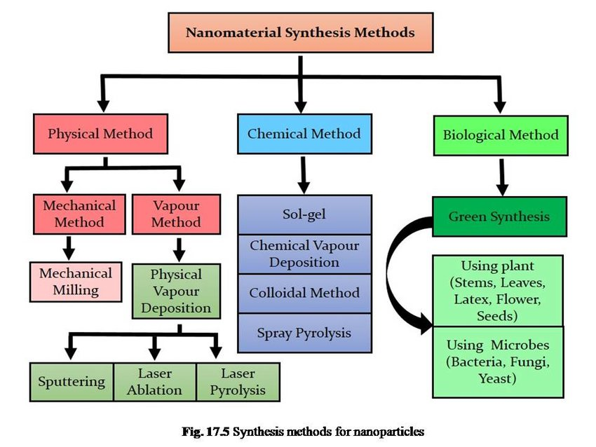
How it is synthesized?!
Nano particles can be synthesized in three methods:-

Slide 5
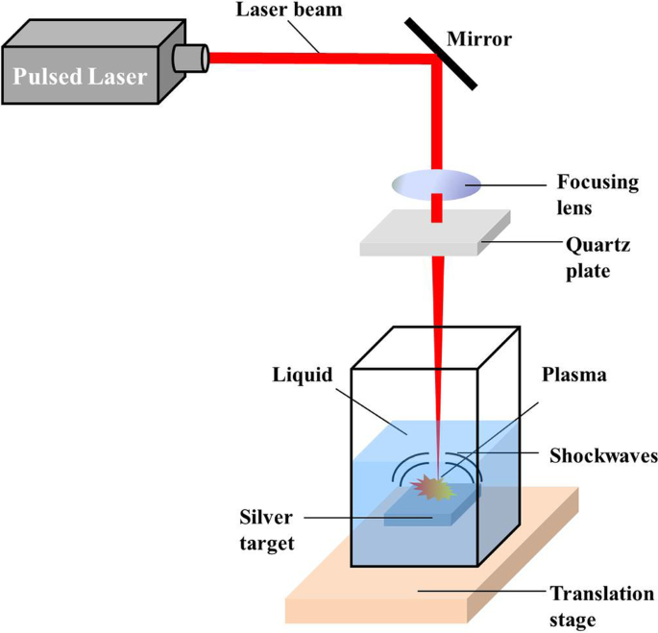
Laser ablation synthesis (LAS) is a commonly used method for obtaining colloidal solution of nanoparticles in a variety of solvents. Nanoparticles (NPs,), are useful in chemistry, engineering and biochemistry due to their large surface-to-volume ratio that causes them to have unique physical properties. LAS is considered a "green" method due to its lack of use for toxic chemical precursors to synthesize nanoparticles. In the LAS method, nanoparticles are produced by a laser beam hitting a solid target in a liquid and during the condensation of the plasma plume, the nanoparticles are formed. Since the ablation is occurring in a liquid, versus air/vacuum/gas/, the environment allows for plume expansion, cooling and condensation with a higher temperature, pressure and density to create a plume with stronger confinement.

Slide 6
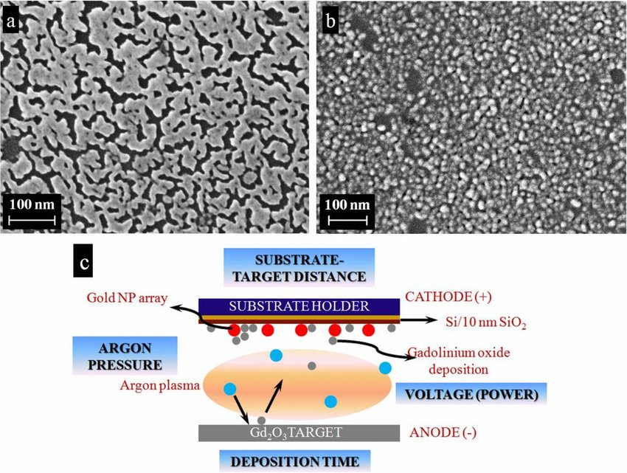
Direct current (DC) Magnetron Sputtering has long been used to fabricate thin films, nanostructured coatings, and nanoparticles of various materials, including metallic oxide, nitride, and carbide films. Recently, Liu et al reported on growth of metal nanoparticles, for example, Au and Ag, using DC sputtering systems. The metal targets were sputtered onto ionic liquids to form self-assembly of metal nanoparticles on carbon supports in the liquid. Thus, DC magnetron sputtering could be a potential technique for synthesizing metal nanoparticles. The technique also reduces the complexity of synthesis processes and facilitates control over size, shape, and aggregation of the nanoparticles. However, little research to date has focused on using this technique to synthesize Ag nanoparticles.

Slide 7
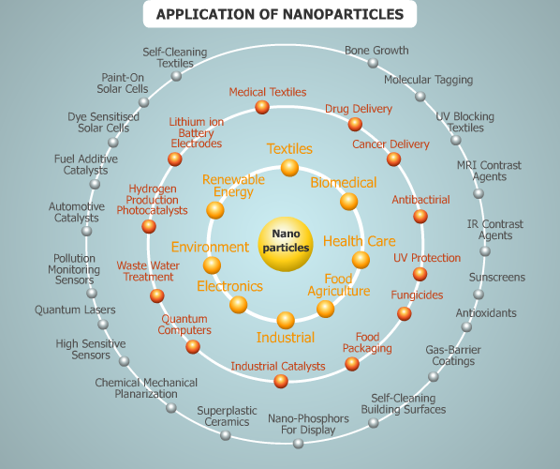
Applications of nanoparticles
Actually em levu, so kutha mooskoni undu

Slide 8
ending
THANK YOU

